Slide 1
CS 61C:
Great Ideas in Computer Architecture
Introduction to Assembly Language and RISC-V Instruction Set Architecture
Instructors:
Krste Asanović & Randy H. Katz
http://inst.eecs.Berkeley.edu/~cs61c
9/7/17
Fall 2017 - Lecture #5

Slide 2
Outline
Assembly Language
RISC-V Architecture
Registers vs. Variables
RISC-V Instructions
C-to-RISC-V Patterns
And in Conclusion …
9/7/17

Slide 3
Outline
Assembly Language
RISC-V Architecture
Registers vs. Variables
RISC-V Instructions
C-to-RISC-V Patterns
And in Conclusion …
9/7/17

Slide 4


Levels of Representation/Interpretation
High Level Language
Program (e.g., C)
temp = v[k];
v[k] = v[k+1];
v[k+1] = temp;
Compiler
Anything can be represented
as a number,
i.e., data or instructions
lw $t0, 0($2)
lw $t1, 4($2)
sw $t1, 0($2)
sw $t0, 4($2)
Assembly Language Program (e.g., RISC-V)
Assembler
0000 1001 1100 0110 1010 1111 0101 1000
1010 1111 0101 1000 0000 1001 1100 0110
1100 0110 1010 1111 0101 1000 0000 1001
0101 1000 0000 1001 1100 0110 1010 1111
Machine Language Program (RISC-V)
Machine Interpretation
Hardware Architecture Description
(e.g., block diagrams)
Architecture Implementation
Logic Circuit Description
(Circuit Schematic Diagrams)
9/7/17

Slide 5
Instruction Set Architecture (ISA)
Job of a CPU (Central Processing Unit, aka Core): execute instructions
Instructions: CPU’s primitives operations
  Like a sentence: operations (verbs) applied to operands (objects) processed in sequence …
  With additional operations to change the sequence
CPUs belong to “families,” each implementing its own set of instructions
CPU’s particular set of instructions implements an Instruction Set Architecture (ISA)
  Examples: ARM, Intel x86, MIPS, RISC-V, IBM/Motorola PowerPC (old Mac), Intel IA64, ...
9/7/17

Slide 6


Assembly Language
High-Level Language
9/7/17

Slide 7


Assembly Language
High-Level Language
9/7/17

Slide 8
Instruction Set Architectures
Early trend: add more instructions to new CPUs for elaborate operations
  VAX architecture had an instruction to multiply polynomials!
RISC philosophy (Cocke IBM, Patterson UCB, Hennessy Stanford, 1980s) – Reduced Instruction Set Computing
  Keep the instruction set small and simple, in order to build fast hardware
  Let software do complicated operations by composing simpler ones
9/7/17

Slide 9
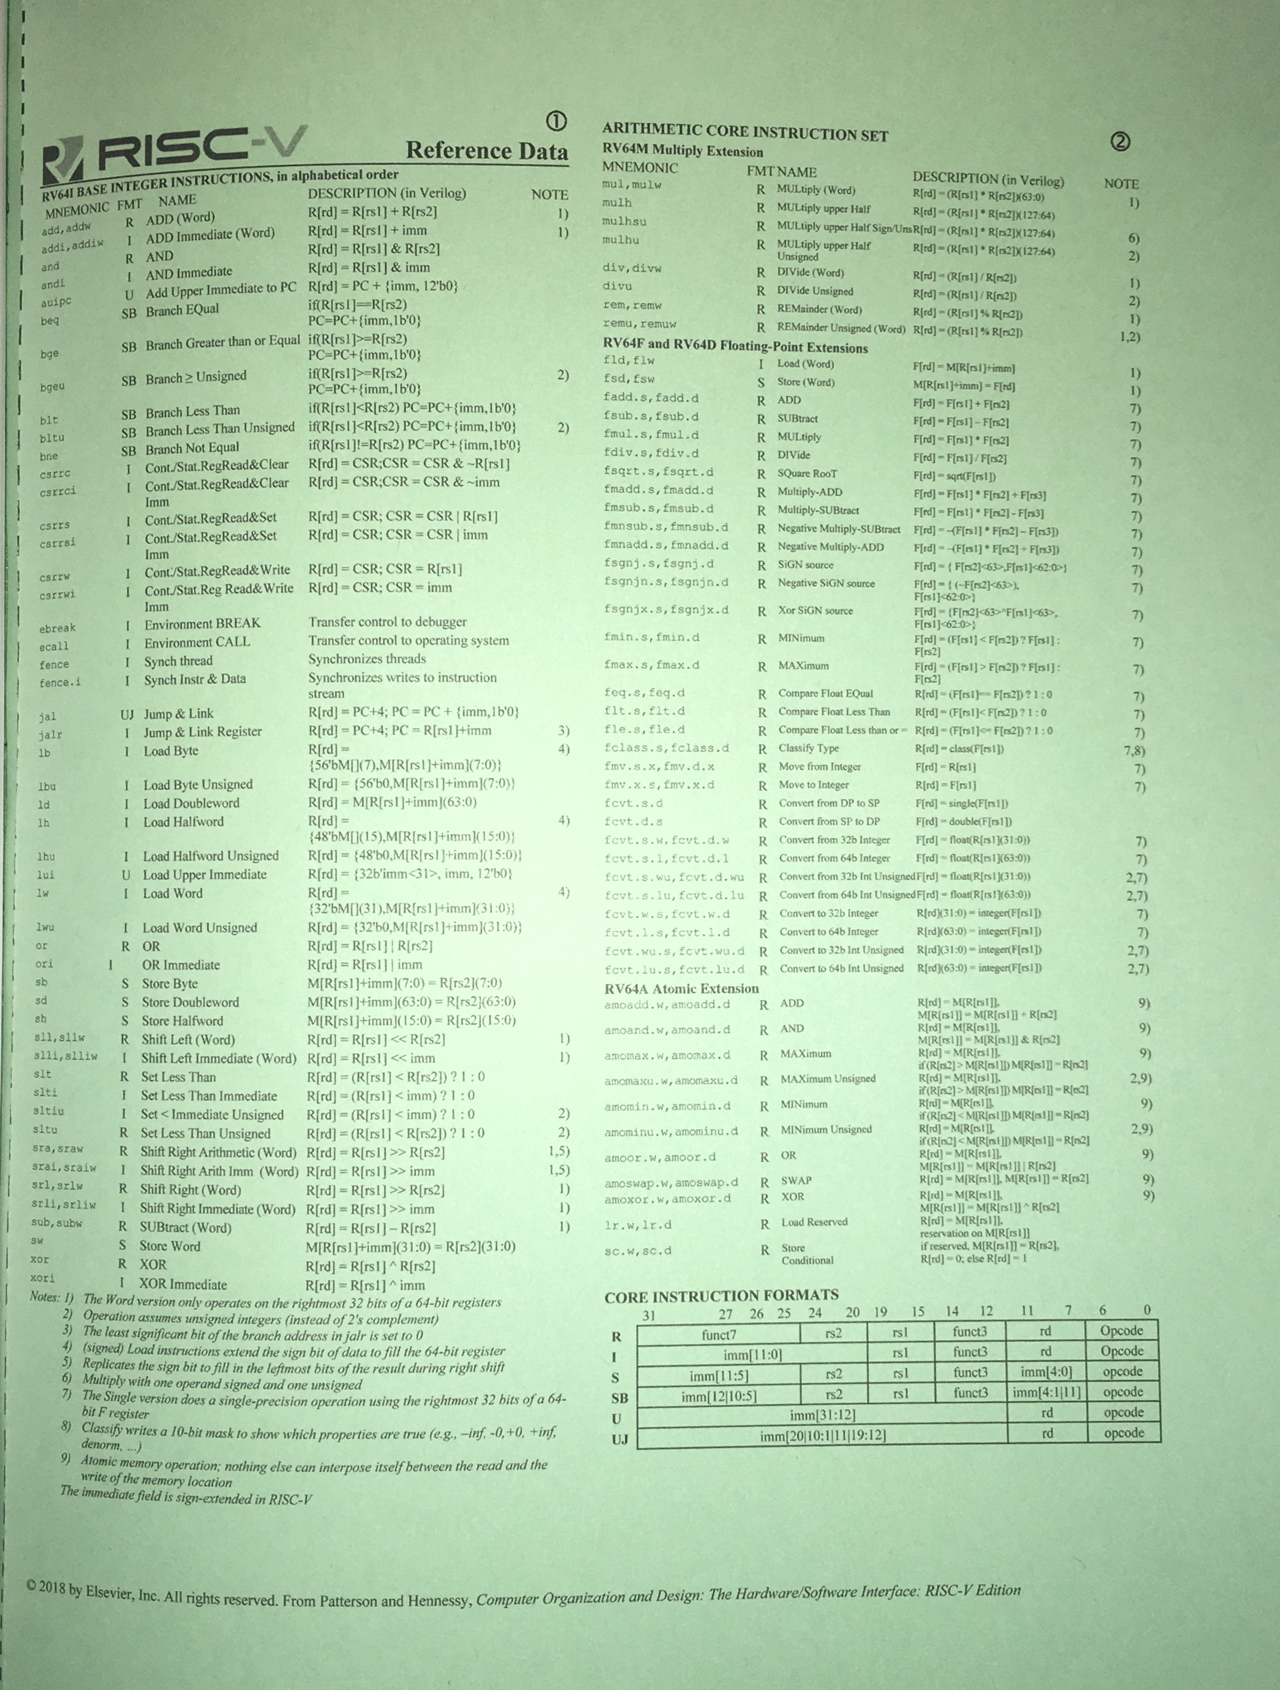
RISC-V
Green Card
(in textbook)
9/7/17
http://inst.eecs.berkeley.edu/~cs61c/resources/RISCV_Green_Sheet.pdf

Slide 10
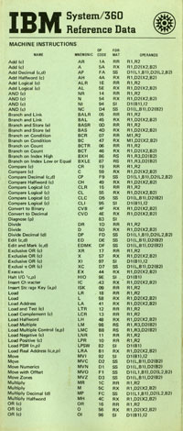
Inspired by the IBM 360
“Green Card”
9/7/17

Slide 11
Outline
Assembly Language
RISC-V Architecture
Registers vs. Variables
RISC-V Instructions
C-to-RISC-V Patterns
And in Conclusion …
9/7/17

Slide 12
What is RISC-V?
Fifth generation of RISC design from UC Berkeley
A high-quality, license-free, royalty-free RISC ISA specification
Experiencing rapid uptake in both industry and academia
Both proprietary and open-source core implementations
Supported by growing shared software ecosystem
Appropriate for all levels of computing system, from microcontrollers to supercomputers
  32-bit, 64-bit, and 128-bit variants (we’re using 32-bit in class, textbook uses 64-bit)
Standard maintained by non-profit RISC-V Foundation
9/7/17

Slide 13

































Foundation Members (60+)
Platinum:
Gold, Silver, Auditors:
Rumble
Development

Slide 14
Outline
Assembly Language
RISC-V Architecture
Registers vs. Variables
RISC-V Instructions
C-to-RISC-V Patterns
And in Conclusion …
9/7/17

Slide 15
Assembly Variables: Registers
Unlike HLL like C or Java, assembly does not have variables as you know and love them
  More primitive, closer what simple hardware can directly support
Assembly operands are objects called registers
  Limited number of special places to hold values, built directly into the hardware
  Operations can only be performed on these!
Benefit: Since registers are directly in hardware, they are very fast (faster than 1 ns - light travels 1 foot in 1 ns!!! )
9/7/17
15

Slide 16
Registers live inside the Processor
Processor
Memory
Enable?
Read/Write
Input
Control
Program
Datapath
Address
PC
Bytes
Registers
Write Data
Arithmetic & Logic Unit
(ALU)
Data
ReadData
Output
Processor-Memory Interface
I/O-Memory Interfaces
Notes:
focus memory

Slide 17
Number of RISC-V Registers
Drawback: Since registers are in hardware, there are a limited number of them
  Solution: RISC-V code must be carefully written to efficiently use registers
32 registers in RISC-V, referred to by number x0 – x31
  Registers are also given symbolic names, described later
  Why 32? Smaller is faster, but too small is bad. Goldilocks principle (“This porridge is too hot; This porridge is too cold; this porridge is just right”)
  Each RISC-V register is 32 bits wide (RV32 variant of RISC-V ISA)
  Groups of 32 bits called a word in RISC-V ISA
  P&H CoD textbook uses the 64-bit variant RV64 (explain differences later)
x0 is special, always holds value zero
  So really only 31 registers able to hold variable values
9/7/17

Slide 18
C, Java Variables vs. Registers
In C (and most HLLs):
  Variables declared and given a type
    Example: int fahr, celsius;
    char a, b, c, d, e;
  Each variable can ONLY represent a value of the type it was declared (e.g., cannot mix and match int and char variables)
In Assembly Language:
  Registers have no type;
  Operation determines how register contents are interpreted
9/7/17

Slide 19
Outline
Assembly Language
RISC-V Architecture
Registers vs. Variables
RISC-V Instructions
C-to-RISC-V Patterns
And in Conclusion …
9/7/17

Slide 20
RISC-V Instruction Assembly Syntax
Instructions have an opcode and operands
E.g., add x1, x2, x3 # x1 = x2 + x3
# is assembly comment syntax
Destination register
Second operand register
Operation code (opcode)
First operand register
9/7/17

Slide 21
Addition and Subtraction of Integers
Addition in Assembly
  Example: add x1,x2,x3 (in RISC-V)
  Equivalent to: a = b + c (in C)
  where C variables ⇔ RISC-V registers are:
  a ⇔ x1, b ⇔ x2, c ⇔ x3
Subtraction in Assembly
  Example: sub x3,x4,x5 (in RISC-V)
  Equivalent to: d = e - f (in C)
  where C variables ⇔ RISC-V registers are:
  d ⇔ x3, e ⇔ x4, f ⇔ x5
9/7/17

Slide 22
Addition and Subtraction of Integers Example 1
How to do the following C statement?
a = b + c + d - e;
Break into multiple instructions
  add x10, x1, x2 # a_temp = b + c
  add x10, x10, x3 # a_temp = a_temp + d
  sub x10, x10, x4 # a = a_temp - e
A single line of C may turn into several RISC-V instructions
9/7/17

Slide 23
Immediates
Immediates are numerical constants
They appear often in code, so there are special instructions for them
Add Immediate:
  addi x3,x4,-10 (in RISC-V)
  f = g - 10 (in C)
  where RISC-V registers x3,x4 are associated with C variables f, g
Syntax similar to add instruction, except that last argument is a number instead of a register
  add x3,x4,x0 (in RISC-V)
  f = g (in C)
9/7/17

Slide 24
Data Transfer:
Load from and Store to memory
Memory
Processor
Enable?
Read/Write
Input
Control
Program
Datapath
Address
Bytes
Much larger place
To hold values, but slower than registers!
PC
Write Data = Store to memory
Registers
Arithmetic & Logic Unit
(ALU)
Data
Read Data = Load from
memory
Output
Fast but limited place
To hold values
Processor-Memory Interface
I/O-Memory Interfaces
9/7/17

Slide 25
Memory Addresses are in Bytes
Data typically smaller than 32 bits, but rarely smaller than 8 bits (e.g., char type)–works fine if everything is a multiple of 8 bits
8 bit chunk is called a byte
(1 word = 4 bytes)
Memory addresses are really
in bytes, not words
Word addresses are 4 bytes
apart
  Word address is same as address of
  rightmost byte – least-significant byte
  (i.e. Little-endian convention)
Least-significant byte in a word
…
…
…
…
…
3
12
13
14
15
2
8
9
10
11
1
4
5
6
7
0
0
1
2
3
7 0
15 8
23 16
31 24
Least-significant byte
gets the smallest address
9/7/17

Slide 26
Transfer from Memory to Register
C code
int A[100];
g = h + A[3];
Using Load Word (lw) in RISC-V:
lw x10,12(x13) # Reg x10 gets A[3]
add x11,x12,x10 # g = h + A[3]
Note: x13 – base register (pointer to A[0])
12 – offset in bytes
Offset must be a constant known at assembly time
9/7/17
Notes:
80 – 5 (Clicker) – 3 (News/Administrativia) = 72 (36 slides max)
Clicker at 20 (half+)

Slide 27
Transfer from Register to Memory
C code
int A[100];
A[10] = h + A[3];
Using Store Word (sw) in RISC-V:
lw x10,12(x13) # Temp reg x10 gets A[3]
add x10,x12,x10 # Temp reg x10 gets h + A[3]
sw x10,40(x13) # A[10] = h + A[3]
Note: x13 – base register (pointer)
12,40 – offsets in bytes
x13+12 and x13+40 must be multiples of 4
9/7/17
Notes:
80 – 5 (Clicker) – 3 (News/Administrativia) = 72 (36 slides max)
Clicker at 20 (half+)

Slide 28
Loading and Storing Bytes
In addition to word data transfers
(lw, sw), RISC-V has byte data transfers:
  load byte: lb
  store byte: sb
Same format as lw, sw
E.g., lb x10,3(x11)
  contents of memory location with address = sum of “3” + contents of register x11 is copied to the low byte position of register x10.
RISC-V also has “unsigned byte” loads (lbu) which zero extend to fill register. Why no unsigned store byte sbu?
zzz zzzz
x10:
xxxx xxxx xxxx xxxx xxxx xxxx
x
byte
loaded
…is copied to “sign-extend”
This bit
9/7/17

Slide 29
Your turn
addi x11,x0,0x3f5
sw x11,0(x5)
lb x12,1(x5)
Answer | x12
RED | 0x5
GREEN | 0xf
ORANGE | 0x3
YELLOW | 0xffffffff

Slide 30
Your turn
addi x11,x0,0x3f5
sw x11,0(x5)
lb x12,1(x5)
Answer | x12
RED | 0x5
GREEN | 0xf
ORANGE | 0x3
YELLOW | 0xffffffff

Slide 31
Speed of Registers vs. Memory
Given that
  Registers: 32 words (128 Bytes)
  Memory (DRAM): Billions of bytes (2 GB to 8 GB on laptop)
and physics dictates…
  Smaller is faster
How much faster are registers than DRAM??
About 100-500 times faster!
  in terms of latency of one access
9/7/17

Slide 32
Administrivia
HW #0 due tomorrow night!
HW #1 will be published soon
  Two-part C programming assignment
Small Group Tutoring sign ups will be out right after today’s lecture
Three weeks to Midterm #1!
9/7/17

Slide 33

Break!
9/7/17

Slide 34
RISC-V Logical Instructions
Useful to operate on fields of bits within a word
  e.g., characters within a word (8 bits)
Operations to pack /unpack bits into words
Called logical operations
Logical operations | C operators | Java operators | RISC-V instructions
Bit-by-bit AND | & | & | and
Bit-by-bit OR | | | | | or
Bit-by-bit XOR | ^ | ^ | xor
Shift left logical | << | << | sll
Shift right logical | >> | >> | srl
9/7/17

Slide 35
Logical Shifting
Shift Left Logical: slli x11,x12,2 #x11=x12<<2
  Store in x11 the value from x12 shifted 2 bits to the left (they fall off end), inserting 0’s on right; << in C
    Before: 0000 0002_{hex}
    0000 0000 0000 0000 0000 0000 0000 0010_{two}
  After: 0000 0008_{hex}
  0000 0000 0000 0000 0000 0000 0000 1000_{two}
  What arithmetic effect does shift left have?
Shift Right Logical: srli is opposite shift; >>
  Zero bits inserted at left of word, right bits shifted off end
9/7/17

Slide 36
Arithmetic Shifting
Shift right arithmetic (srai) moves n bits to the right (insert high-order sign bit into empty bits)
For example, if register x10 contained
  1111 1111 1111 1111 1111 1111 1110 0111_{two}= -25_{ten}
If execute sra x10, x10, 4, result is:
1111 1111 1111 1111 1111 1111 1111 1110_{two}= -2_{ten}
  Unfortunately, this is NOT same as dividing by 2^{n}
    Fails for odd negative numbers
    C arithmetic semantics is that division should round towards 0
9/7/17
Notes:
\

Slide 37
Computer Decision Making
Based on computation, do something different
In programming languages: if-statement
RISC-V: if-statement instruction is
beq register1,register2,L1
means: go to statement labeled L1
if (value in register1) == (value in register2)
….otherwise, go to next statement
beq stands for branch if equal
Other instruction: bne for branch if not equal
9/7/17

Slide 38
Types of Branches
Branch – change of control flow
Conditional Branch – change control flow depending on outcome of comparison
  branch if equal (beq) or branch if not equal (bne)
  Also branch if less than (blt) and branch if greater than or equal (bge)
Unconditional Branch – always branch
  a RISC-V instruction for this: jump (j)
9/7/17

Slide 39
Outline
Assembly Language
RISC-V Architecture
Registers vs. Variables
RISC-V Instructions
C-to-RISC-V Patterns
And in Conclusion …
9/7/17

Slide 40
Example if Statement
Assuming translations below, compile if block
f → x10 g → x11 h → x12
i → x13 j → x14
if (i == j) bne x13,x14,Exit
f = g + h; add x10,x11,x12
Exit:
May need to negate branch condition
9/7/17

Slide 41
Example if-else Statement
Assuming translations below, compile
f → x10 g → x11 h → x12
i → x13 j → x14
if (i == j) bne x13,x14,Else
f = g + h; add x10,x11,x12
else j Exit
f = g – h; Else: sub x10,x11,x12
Exit:
9/7/17

Slide 42
Magnitude Compares in RISC-V
Until now, we’ve only tested equalities (== and != in C);
General programs need to test < and > as well.
RISC-V magnitude-compare branches:
  “Branch on Less Than”
  Syntax: blt reg1,reg2, label
  Meaning: if (reg1 < reg2) // treat registers as signed integers goto label;
“Branch on Less Than Unsigned”
  Syntax: bltu reg1,reg2, label
  Meaning: if (reg1 < reg2) // treat registers as unsigned integers goto label;
9/7/17

Slide 43
C Loop Mapped to RISC-V Assembly
int A[20];
int sum = 0;
for (int i=0; i<20; i++)
sum += A[i];
add x9, x8, x0 # x9=&A[0]
add x10, x0, x0 # sum=0
add x11, x0, x0 # i=0
Loop:
lw x12, 0(x9) # x12=A[i]
add x10,x10,x12 # sum+=
addi x9,x9,4 # &A[i++]
addi x11,x11,1 # i++
addi x13,x0,20 # x13=20
blt x11,x13,Loop

Slide 44
Outline
Assembly Language
RISC-V Architecture
Registers vs. Variables
RISC-V Instructions
C-to-RISC-V Patterns
And in Conclusion …
9/7/17

Slide 45
In Conclusion,…
Instruction set architecture (ISA) specifies the set of commands (instructions) a computer can execute
Hardware registers provide a few very fast variables for instructions to operate on
RISC-V ISA requires software to break complex operations into a string of simple instructions, but enables faster, simple hardware
Assembly code is human-readable version of computer’s native machine code, converted to binary by an assembler

